Slide 1


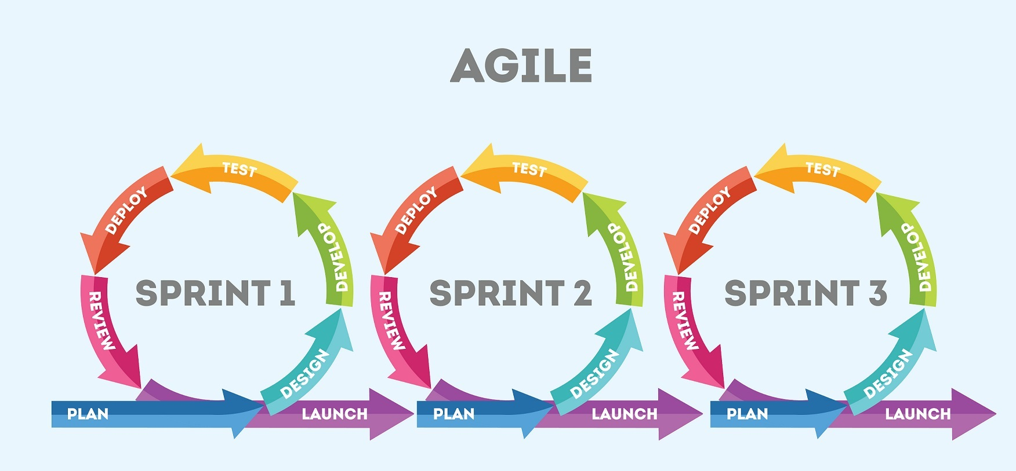

Smooth Player
Online Music Player
Mobile Application
Tools
App Design
Software Development Methodology
Backend
Database

Slide 2

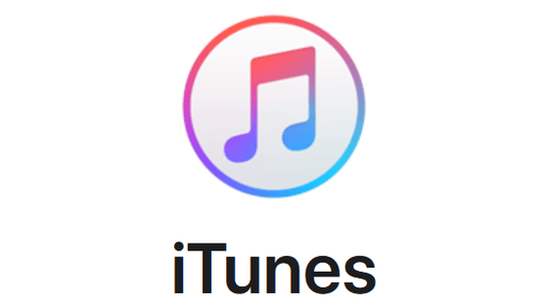


Existing Online Music Players
Free to use but limited feature
Have to buy subscription for more useful features
Free version listener have to listen advertisement
Free versions have limited song skip options
Those who have subscription, they can only upload music
Distribution on limited countries
Common Features
Search and Sort Songs
Play songs
Like songs
Create Playlist

Slide 3
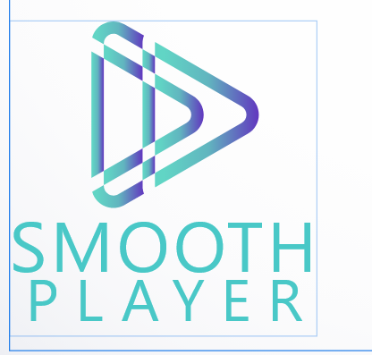
Smooth Player
Search Artist, Albums, Songs
Follow Artist
Give like to the albums
Give like to the songs
Add or remove music from the queue
Auto play similar music when reaching the end of an album
Play songs form the random playlist
Make your library
Create your playlist
Add or remove songs from the playlist
View followed artist and albums
Upload own music
View other user’s liked songs and followed artists if they have made it public

Slide 4
AGILE
Reduces Maintenance tasks like defect resolution, refactoring, and testing.
Easily and Quickly Adapt to Change
Using Agile for Mobile Application Development and Testing Creates Total Alignment and Transparency
Test minimize risk
Higher Quality Product
Predictable Delivery Dates
Better Stakeholder Engagement
User Focused Testing
Greater Customer Satisfaction
Better Project Control

